Slide 1
Predicting a Venue’s Price Range in Brooklyn Using Foursquare Location Data
IBM Data Science Capstone Project
Michelle Sun

Slide 2
The problem
The price range for a restaurant can depend a range of factors like the cost of rent, labor and raw ingredient. These types of data are hard to gauge from your potential competitors in the area, but they are correlated to the location of the venue and the type of food it serves. Before opening the business, one would naturally want to know the profitability of the new venture by knowing what kind of prices it can charge the customers.

Slide 3
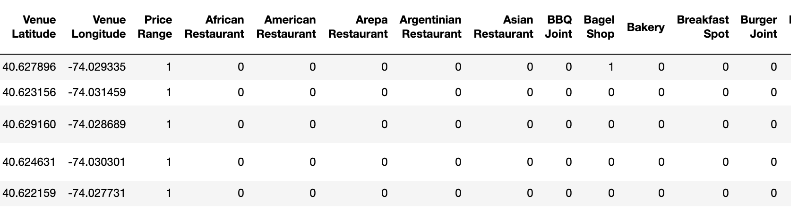
The data
From the Foursquare api free calls we can retrieve a data frame with the venue location, its neighborhood, category and price range.
The data need to be cleaned for machine learning purposes and it will look like this:

Slide 4
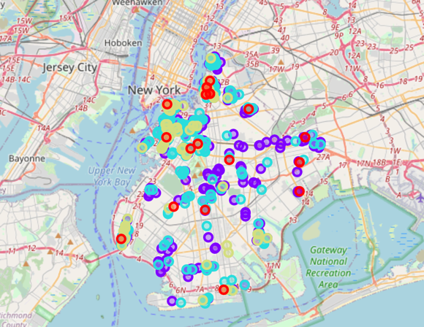
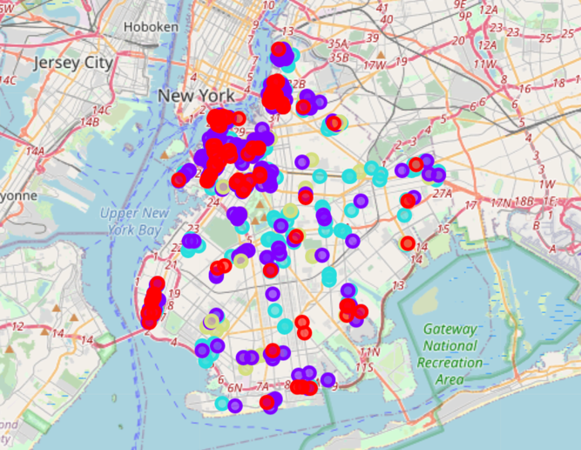
Unsupervised clustering after taking the category into account, the unsupervised k means can form clusters that still fell into different price ranges.
Cluster by price range
Cluster by k means

Slide 5
Supervised Classification
80:20 training test split
Drop neighborhood location and venue names
Use K Nearest Neighbours, Neural Networks, Support Vector Machines, Decision Tree and Logistic Regression
Normalise the data
Use grid search and cross validation to find suitable parameters

Slide 6
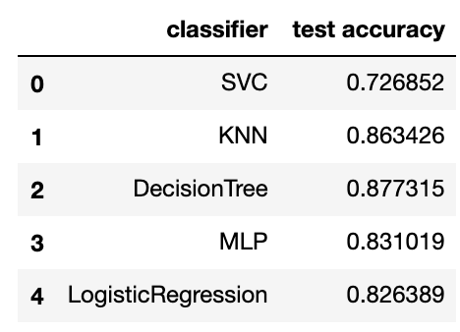
Results
KNN and Decision Tree performed especially well in this case.

Slide 7

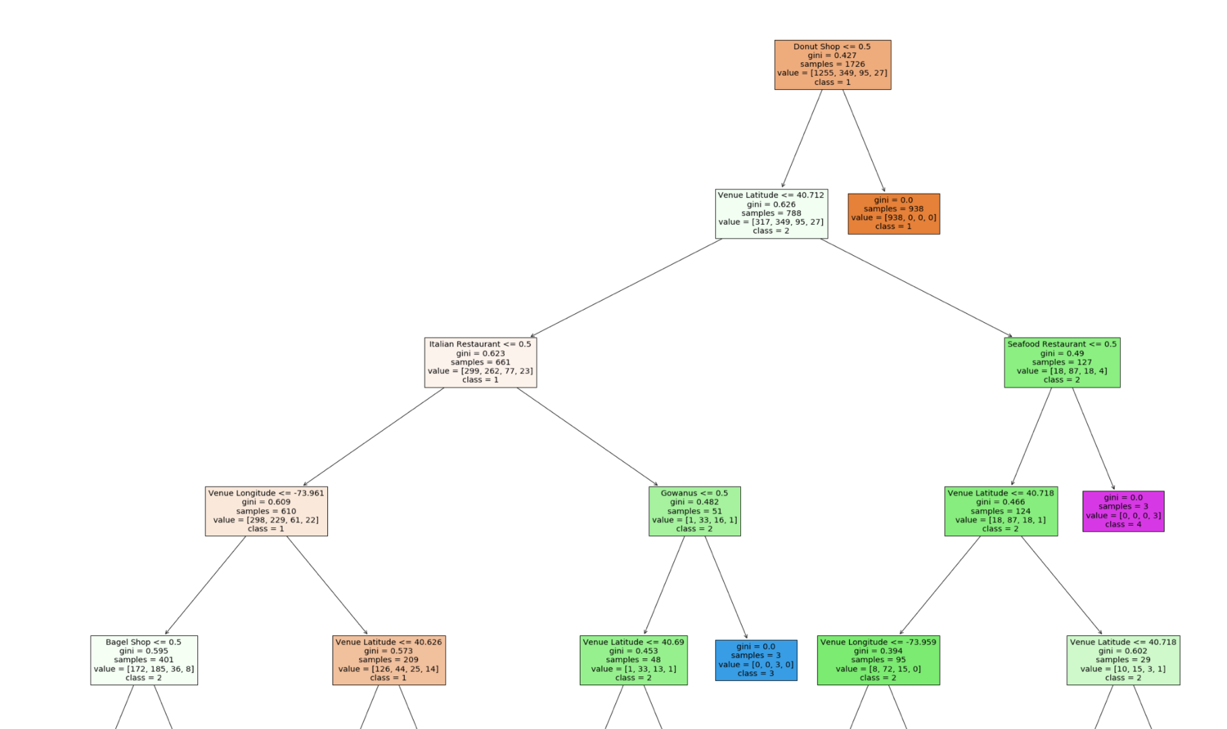
Discussion
KNN makes more intuitive sense as we can examine the ‘neighbors’ of a particular test case.
Decision tree can be used to eliminate redundant features. And to spot apparent rules.
The data is not very linearly separable.

Slide 8
Conclusion
More precise price data (menu and price per item) is needed for more accurate prediction.
Use a regression model with precise price can better help the pricing strategy rather than a classification algorithm.

